Slide 1

Introduction to Authoring Systems

Slide 2

Learning Outcomes:
Unit 3: What are Authoring Systems?
Unit 4: Evolution of Authoring Systems
Advantages of Authoring Systems
Unit 5: Authoring Interface
Slide Show Metaphor
Book Metaphor
Timeline Metaphor
Icon Metaphor

Slide 3
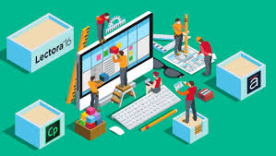
What is Multimedia Authoring?
It is a process of assembling different types of media contents like text, audio, image, animations and video as a single stream of information with the help of various software tools

Slide 4
What are Authoring Systems?

Slide 5
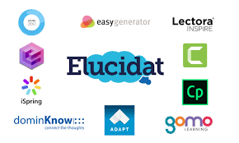
What are Authoring Systems?
Authoring tools enable non-professional programmers like educators, teachers and learners to design interactive multimedia and hypermedia learning environments.

Slide 6
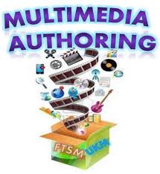
What are Authoring Systems?
Multimedia authoring tools provide the framework for organizing and editing the elements of a multimedia project.

Slide 7
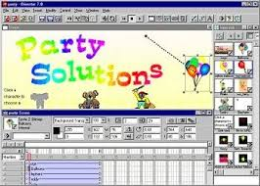
What are Authoring Systems?
Authoring software provides an integrated environment for combining the content and functions of a project.

Slide 8
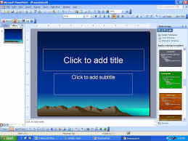
What are Authoring Systems?
It enables the developer to combine text, graphics, audio, video and animation to create an interactive presentation/project. E.g. MS PowerPoint

Slide 9
What are Authoring Systems?
Authoring tools are used for designing interactivity and the user interface, for presenting your project on screen and assembling multimedia elements into a single project.

Slide 10
Features of Authoring Tools
Editing and organizing features
Programming features
Interactivity features
Playback features
Cross-platform feature

Slide 11

Authoring Systems are Similar to Programming Languages
Authoring tools however accomplish their tasks using a certain methodology or paradigm that requires a type of algorithmic thinking similar to that of programming languages

Slide 12
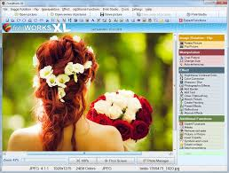
What are Authoring Systems?
Generally authoring systems provide many graphics, much interaction, and other tools educational software needs.

Slide 13
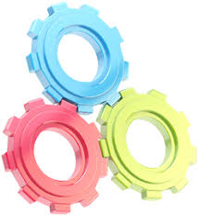
What are Authoring Systems?
The three main components of an authoring system are: content organization, control of content delivery, and type(s) of assessment.

Slide 14

What are Authoring Systems?
Content Organization allows the user to structure and sequence the instructional content and media.

Slide 15
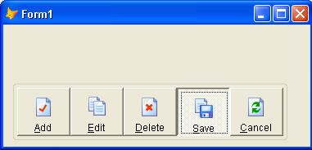

What are Authoring Systems?
Control of content delivery refers to the ability for the user to set the pace in which the content is delivered, and how learners engage with the content.

Slide 16
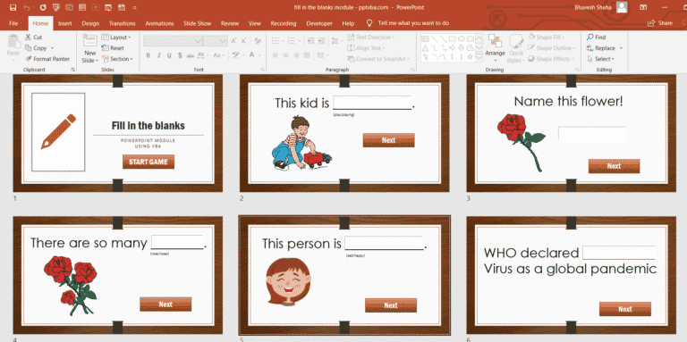
What are Authoring Systems?
Assessment refers to the ability to test learning outcomes within the system, usually in the form of tests, discussions, assignments, and other activities which can be evaluated.

Slide 17
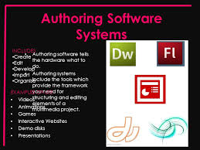
What are Authoring Systems?
An authoring system usually includes an authoring language, a programming language built (or extended) with functionality for representing the tutoring system.

Slide 18
Examples of Multimedia Authoring Systems
Hypercard
Tool Book
Hyper Next Studio
Hyper Studio
Phyton Card
Revolution
Director
Flash (no longer supported)
Macromedia Authorware
Icon Author
Microsoft PowerPoint

Slide 19
Examples of Multimedia Authoring Systems
Examples of Waveform Editor:
Adobe Audition
• Creative Wavestudio
• Goldwave
• Sound Forge
• Wavelab

Slide 20
Examples of Multimedia Authoring Systems
Examples of Video Editing Program
Adobe Premiere
• Pinnacle Studio
• Video Studio
• Windows Movie Maker

Slide 21
What are Authoring Systems?
Authoring systems can be defined as software that allows its user to create multimedia applications for manipulating multimedia objects.
An authoring environment is toolkit to build software or digital contents.

Slide 22
In the development of educational software, an authoring system is a program that allows a non-programmer, usually an instructional designer or technologist, to easily create software with programming features.

Slide 23
The programming features are built in but hidden behind buttons and other tools, so the author does not need to know how to program.

Slide 24
The premise behind authoring tools is the absence of a programmer or the ability of designers with little or no programming experience to develop and design instructional applications"

Slide 25
In essence authoring tools are an accelerated application or simplified form of programming by virtue of their inclusion of pre-programmed elements for the development of interactive multimedia and the &ployment of a point and click user interface to activate these elements

Slide 26
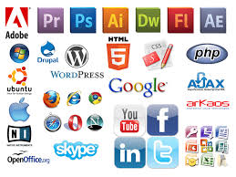
What are Authoring Systems?
Some of these paradigms include the scripting metaphor, the card-scripting metaphor, iconic/flow control, hypermedia linkage, the frame metaphor, the cast-score metaphor, the hierarchical object metaphor etc.

Slide 27
The functionality offered by the authoring language may be programming functionality for use by programmers or domain representation functionality for use by subject experts. There is overlap between authoring languages with domain representation functionality and domain-specific languages.

Slide 28
Multimedia Authoring Paradigms
The authoring paradigm, or authoring metaphor, is the methodology by which the authoring system accomplishes its task.
There are various paradigms, including:
Scripting Language
Iconic/Flow Control
Card/scripting metaphor
Frame metaphor

Slide 29
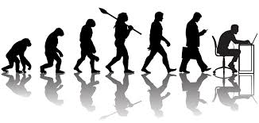
Unit 4: Evolution of Authoring Systems
Authoring tools have evolved over the last decade based on technological and pedagogical innovations

Slide 30
Evolution of Authoring Systems
From authoring bounded (created with one specific authoring system), program-controlled learning systems such as Computer-Based Instruction (CBI) to authoring unbounded, learner-centered environments such as Web-Based Instruction (WBI).

Slide 31
What has Changed?
Ten years ago there were no smartphones or tablets.
Only desktops and laptops – these are identical devices in terms of playing back eLearning content

Slide 32
What has changed?
Then came flash - a technology that allowed for rich eLearning interactions and, more importantly, rendered identically across all browsers.

Slide 33
What has changed?
All we had to do was create a tool that could output in Flash at a resolution of 1024×768 and everyone was happy.

Slide 34
Evolution of Authoring Systems
Now, flash has disappeared from the multimedia environment – flash has been discontinued (no longer supported) as its been replaced with HTML 5.

Slide 35
Evolution of Authoring Systems
PLATO-like systems
Programming toolkits for Videodisks
Programming toolkits with multimedia extensions
Multimedia authoring systems
Web authoring systems
Learning object repository and educational object communities

Slide 36
Evolution of Authoring Systems
PLATO', an acronym for Programmed Logic for Automatic Teaching Operations was an early Computer-based training system.
First a single user system in 1960, it became multi-user in the mid-sixties. DSchneider believes that PLATO was the first e-learning platform. Principles behind courseware were not too different from modern-day content-based main-stream e-learning.
The only difference is that early PLATO systems did not incorporate the typical CMC components a modern Learning management system has. But already by the mid-70's, PLATO featured on-line talk and messaging. Plato also included some of the first online games and multi-user virtual environments.

Slide 37
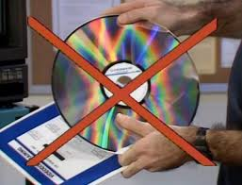
After PLATO came Programming toolkits for Videodisks
A Videodisk (or videodisc) is a digital recording (e.g. video or audio) on an optical disk that can be played on a computer or a television set.
This technology has been replaced by DVDs, but there are still working installations in use for training.

Slide 38
Programming toolkits
Programming toolkits are tools that help programming with a given programming language with the help of some software engineering method.
A toolkit is a collection of tools that are useful in a given programming environment. Examples include: code compilers, resource compilers, code generators, code formatters, build systems. Exactly which tools are provided by a toolkit will depend on the nature of the platform involved.

Slide 40
Advantages of Authoring Systems
1. Simplicity of use
For Teachers
They are generally easier to use as compared to using programming languages to create multimedia and other educational applications.

Slide 41
For Learners
24/7 access from any device
Also easy to access interactive content such as games, audio, videos etc,
Vertical scrolling for reading on smartphones
Today’s authoring tools provide users with a hassle-free and engaging multi-device experience.

Slide 42
Advantages of Authoring Systems
Developing Multimedia Applications without advanced Programming Knowledge
Multimedia authoring tools allows teachers to effortlessly create attractive and dynamic applications that impact their audiences in a big way.
Thanks to an intuitive, easy-to-use interface, editors can modify elements, move layouts, and customize even the smallest details of their presentations in a few simple clicks, without needing to have technical or design knowledge.

Slide 43
Advantages of Authoring Systems
Multi-device compatibility
They can be used to design multimedia presentations that can run on smart phones, tablets as well as personal computers

Slide 44
Advantages of Authoring Systems
Content adapts automatically to different devices without compromising on exceptional usability and quality. This enables users to access information immediately and on demand, whether they’re on the subway heading to work or at home relaxing on the sofa.

Slide 45
Advantages of Authoring Systems
Interactive multimedia content
All this interactive content, when paired with well-written text, has the power to engage your students, giving authoring tools the advantage over other traditional tools when it comes to creating e-learning courses.

Slide 46
Advantages of Authoring Systems
Collaboration and Teamwork
The newest authoring tools utilize cloud technology to allow multiple users to work simultaneously on creating e-learning courses.
This collaboration extends not merely to the same project or section, but even to the same presentation slide

Slide 47
Advantages of Authoring Systems
Availability
Multimedia tools like MS PowerPoint, Adobe Flash (deprecated) and Macromedia Dreamweaver are readily available

Slide 48
Advantages of Authoring Systems
Reducing Cost of Buying Software
When authoring tools are embedded with an eLearning platform, the cost of using additional software, and media elements is reduced. These tools help to design short and crisp content which is easier to understand and recall.

Slide 50
Unit 5: Authoring Interface
User Interface Design Multi media applications contain user interface design.

Slide 51
Authoring Interface
Designing user Interfaces
User Interface should be designed by structured following design guidelines as follows:
1.Planning the overall structure of the application
2.Planning the content of the application
3.Planning the interactive behavior
4.Planning the look and feel of the application
A good user interface must be efficient and intuitive by most users

Slide 52
The methodology by which the authoring system accomplishes its task is known as it’s authoring metaphor
Metaphors for multimedia applications include:
Slide Show Metaphor
Book Metaphor
Timeline Metaphor
Icon Metaphor

Slide 53
TimeLine –Metaphor
In a timeline based authoring system, objects are placed along a timeline. The timeline can be drawn on the screen in a window in a graphic manner, or it created using a script in a mann.er similar to a project plan. But, the user must specify a resource object and position it in the timeline.
On playback, the object starts playing at that point in the time Scale. Fig:TimeLinebased authoring

Slide 54
In most timeline based approaches, once the multimedia object has been captured in a timeline,.it is fixed in location and cannot be manipulated easily, So, a single timeline causes loss of information about the relative time lines for each individual object.

Slide 55
Slide Show Metaphor
One of the most common approaches used by first-time developers as well as for creating linear presentations is Slide Show Metaphor.
A linear presentation by default, although tools exist to perform jumps in slide shows.

Slide 56
Advantages of Slide Show Metaphor
Inexpensive
Easy to Learn
Easy to Use
Cross-Platform
Disadvantages
Linear
Non-Interactive

Slide 57
Software that uses Slide Show Metaphor
MS Powerpoint
Camtasia
Adobe Flash (Replaced with Animate)
Slide Share
Live to Video
Prezi

Slide 58
PowerPoint for Multimedia
PowerPoint is a powerful tool for creating multimedia applications for the classroom. It is one of the most frequently used tools to present multimedia for educational purposes.

Slide 59
Camtasia for Multimedia Presentations
Camtasia ( formerly Camtasia Studio ) is a software suite , It is created & published by TechSmith , It is used for creating video tutorials & presentations directly via the screen-cast or via the direct recording plug-in to Microsoft PowerPoint

Slide 60
Slide Show Metaphor
Camtasia consists of two main components which are Camtasia Recorder & Camtasia editor , Camtasia Recorder is a separate tool for capturing screen audio & video.
Camtasia editor is the component for which the entire product is named , that is a multimedia authoring tool with the industry standard “timeline” interface for managing multiple clips in a stacked track form plus many enhancements .

Slide 61
Slide Show Metaphor
Slide Show Metaphor applications include MS PowerPoint and ImageQ

Slide 62
Book Metaphor
Many of the representation authoring products use the slide show metaphor including Lotus Freelance and Software Publishing’s Harvard Graphics.

Slide 63
While this approach is excellent for authoring linear presentations, it is not optimum when random interactivity is needed, because you are constrained only to jumping around in a straight line of slides

Slide 64
he Book Metaphor/Page metaphor To build an application more complex than a linear presentation, with navigational and user interactivity facilities one could select the Page metaphor. For better interactivity you need to build a multidimensional structure.

Slide 65
One metaphor for that is the book. One such tool is the Asymetrix ToolBook. In this metaphor you think of an application as a book containing any number of pages or discreet units of information/interaction linked together to form a sort of a book. Each page is a screen shown in its own window

Slide 66
Timeline/Flow Chart Metaphor
they let you assemble materials into a sequence, as if you were creating a sort of “movie”. This metaphor can be useful for a project that has definite starting point, path, ending point, such as a presentation, animation or game.

Slide 67
Tools using this paradigm are Action, Macromedia Director, Stanford University’s MAEstro. This is also called the Cast/Score/Scripting paradigm where the synchronous elements are shown in various horizontal tracks, which are simultaneously shown via the vertical columns.

Slide 68
Some applications, or parts of applications, lend themselves to timeline authoring. With this metaphor you work with a time scale diagram and you place objects and events on the time scale in correct relationship to each other.

Slide 69
This is especially valuable when you are dealing with a lot of animation or other dynamic activity. Macromedia Action! and Director are good examples of presentation assembly program that contain the timeline approach

Slide 70
It is generally accepted that the Flowchart/timeline metaphor is less than ideal for CBT projects. CBT authors indicate that a flowchart is the least desirable feature in a CBT

Slide 71
Icon Metaphor
The Icon Metaphor An authoring metaphor that is particularly suited to authoring by non-programmers is the Icon metaphor. Most authoring tools use icons in one form or another. An icon is a pictorial representation of an object, container or process. An authoring system may contain icons for text, buttons, pictures etc.; often clicking on an icon lets you then modify the item it represents.

Slide 72
This metaphor is the basis of Aimtech’s IconAuthor as well as Macromedia’s Authorware product. Here the application structure is built by dragging icons from an icon palette into the application workspace and connecting them to create the logic of the application. This is usually done as a flowchart. Then each icon is “opened” to reveal a dialog box that allows the properties and the content of that object to be defined. No scripting is required, and there is no language.

Slide 73
There are about 50 types of icons in IconAuthor, which provide support for all computer functions and all multimedia functions. Audio, video and animation are supported via MCI. DDE is also supported. Most of the flexibility of a language is provided in IconAuthor, without requiring any programming

Slide 74
However developing sophisticated applications is still a difficult and complex task, but the author can concentrate on the application logic and content rather than on the details of programming and language syntax. But concentrating on logic still embodies some of the structural concepts of programming - an author planning to do complex applications will need training in the concepts, loops, data structures, nesting etc.

Slide 77
Factors to consider in choosing a Metaphor
Each metaphor has advantages and disadvantages; the choice between them depends on the kinds of work you will be doing and on your personal preferences.

Slide 78
One can also ask oneself the following classes: • What is my expertise in programming? • What is the expertise within my team? • What is the purpose of the proposed application? • How fast does my client want this project done? • What is the budget? • How fancy does the application need to be?

Slide 79
Suggested software for different uses: Proposed Use Suggested Software Business Astound Macromedia Action Macromedia Authorware Education Macromedia Director 5.0 Macromedia Authorware Asymetrix ToolBook HyperCard Games Macromedia Director 5.0

Slide 80
In general Macromedia Authorware and Asymetrix ToolBook are good in terms of overall interactivity

Slide 82
Compare

